Slide 1

Hybris Payment Integration
Integrate with China Union Pay
Tony_tong@epam.com

Slide 2














Hybris INTRODUCE
orders
commerce
content
channel
platform
Full description and documentation can be found here:
wiki.hybris.com/display/release5/Release+5+Documentation+Home

Slide 3

Hybris Sample

Slide 4

China Union pay INTRODUCE
UnionPay International (UPI) is a subsidiary of China UnionPay focused on the growth and support of UnionPay’s global business.
In partnership with more than 1000 institutions worldwide, UnionPay International has enabled card acceptance in over 150 countries and regions with issuance in more than 40 countries and regions.
UnionPay International provides high quality, cost effective and secure cross-border payment services to the world’s largest cardholder base and ensures convenient local services to a growing number of global UnionPay cardholders and merchants.

Slide 5
China Union pay INTRODUCE
Online Support:
https://merchant.unionpay.com
Test Front Trans URL: https://101.231.204.80:5000/gateway/api/frontTransReq.do
Test Bank Card:
Card Num: 6216261000000000018
Phone:13552535506
Password: 123456
ID: 341126197709218366
SMS Verify Code: 111111

Slide 6
China pay: api&utils
Secure API com/unionpay/sdk/SecureUtil.java
Sign Utils com/unionpay/sdk/SDKUtil.java
CertUtil Tool com/unionpay/sdk/CertUtil.java
Constants com/unionpay/sdk/SDKConstants.java
Config com/unionpay/sdk/SDKConfig.java
Date Util com/unionpay/sdk/UtilDate.java

Slide 7
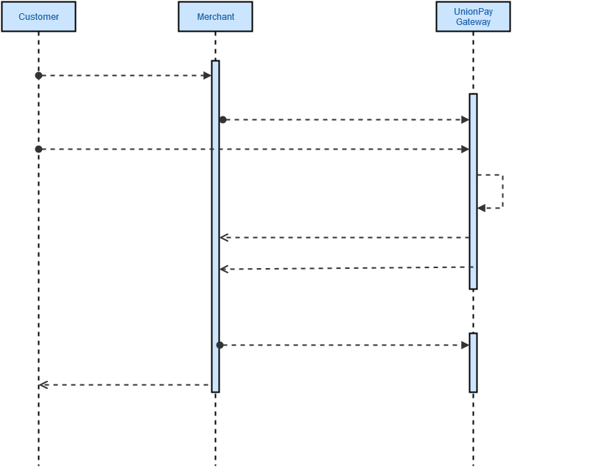
Union pay GaTeway WORKFLOW

Slide 8
Integration overview
Step1.Prepare payment info
Step2.Collect order information
Step3.Organize Payment request
Step4.Handle Chinapay response

Slide 9
Step 1: prepare payment info
Select payment method with AJAX
Create the payment info model for current order

Slide 10
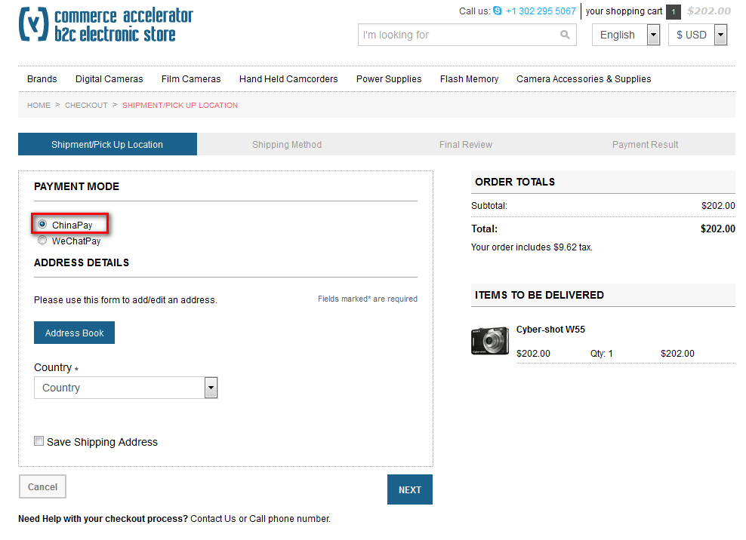
UI Part: Select Payment method

Slide 11
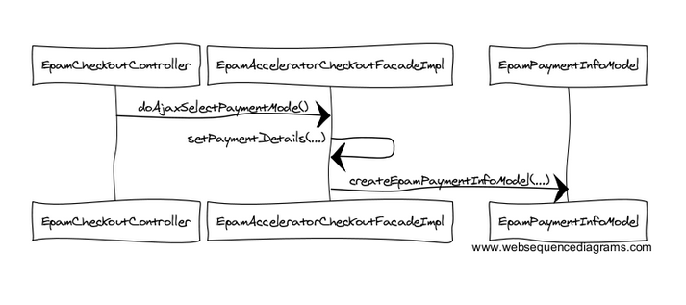
sequence Chart

Slide 12
Step 2: Collect order information
Create Order data and convert order
Populate the payment transition

Slide 13
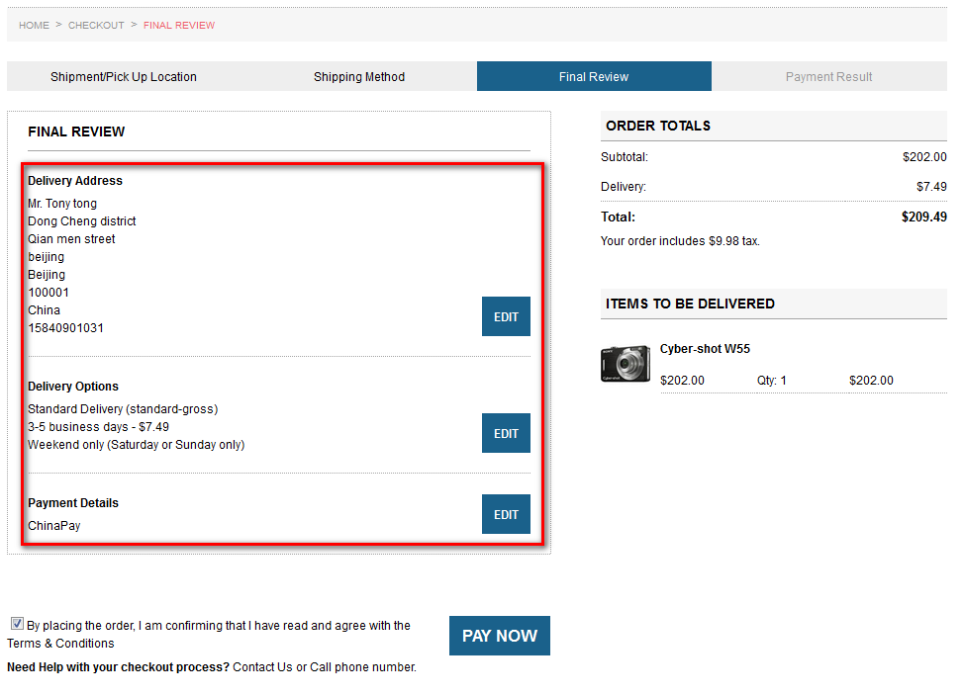
UI Part: Order dATA

Slide 14
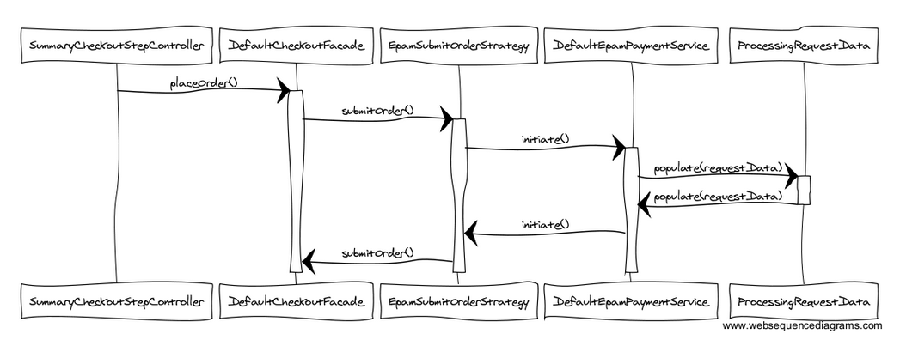
Sequence Chart

Slide 15
2.1 Create order data
SummaryCheckoutStepController:
orderData = getCheckoutFacade().placeOrder();
EpamSubmitOrderStrategy :
@Override public void submitOrder(final OrderModel order) { getEpamPaymentService().initiate(order); }
DefaultEpamPaymentService
public boolean initiate(final OrderModel order) { if (paymentInfoModel instanceof EpamPaymentInfoModel) { ProcessingRequestData requestData = getRequestDataConverter().convert(order); getPaymentTransactionPopulator().populate(requestData, order);} } …….}

Slide 16
IMPLEMENT: 2.2 CONVERT ORDER DATA TO REQUEST DATA
ChinapayPaymentTransactionPopulator :
public void populate(ProcessingRequestData requestData, OrderModel order) throws ConversionException { /* * Setting up EpamPaymentInfoModel * */ EpamPaymentInfoModel paymentInfo = (EpamPaymentInfoModel) order.getPaymentInfo(); BaseRequestData baseData = requestData.getBaseRequestData(); paymentInfo.setOutTradeNo(baseData.getRequestId()); ……. getModelService().save(paymentInfo); getModelService().save(order);
……}

Slide 17
Step 3: Organize Payment request
Prepare the request field with sign data
Fill the automation request form
Send the request

Slide 18
3.1 Prepare the request field With Sign data
DefaultEpamPaymentService:
public String getRedirectPostFormString(OrderModel orderModel) ;
public String initiateHiddenPostForm(orderModel, requestData );
DefaultChinapayCoreService:
public Map<String, String> signData(Map<String, ?> contentData) { ….. SDKUtil.sign(submitFromData, encoding); return submitFromData;
…… }

Slide 19
IMPLEMENT: 3.2 FILL THE automation REQUEST FORM
Automatic request Utils:
public static String createHiddenPostHtml(String action, Map<String, String> hiddens) { StringBuffer sf = new StringBuffer(); sf.append("<html><head><meta http-equiv=\"Content-Type\" content=\"text/html; charset=UTF-8\"/></head><body>"); sf.append("<form id = \"pay_form\" action=\"" + action + "\" method=\"post\">"); if (null != hiddens && 0 != hiddens.size()) { Set<Map.Entry<String, String>> set = hiddens.entrySet(); Iterator<Map.Entry<String, String>> it = set.iterator(); while (it.hasNext()) { Map.Entry<String, String> ey = it.next(); String key = ey.getKey(); String value = ey.getValue(); sf.append("<input type=\"hidden\" name=\"" + key + "\" id=\"" + key + "\" value=\"" + value + "\"/>"); } } sf.append("</form>"); sf.append("</body>"); sf.append("<script type=\"text/javascript\">"); sf.append("document.all.pay_form.submit();"); sf.append("</script>"); sf.append("</html>"); return sf.toString(); }

Slide 20
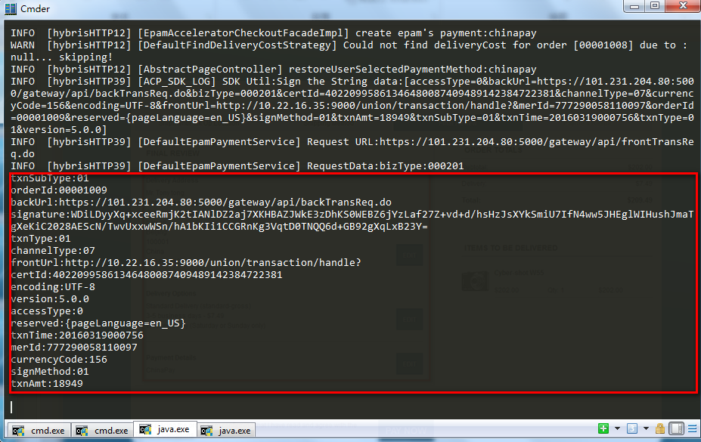
Request data: Order fIELDS

Slide 21
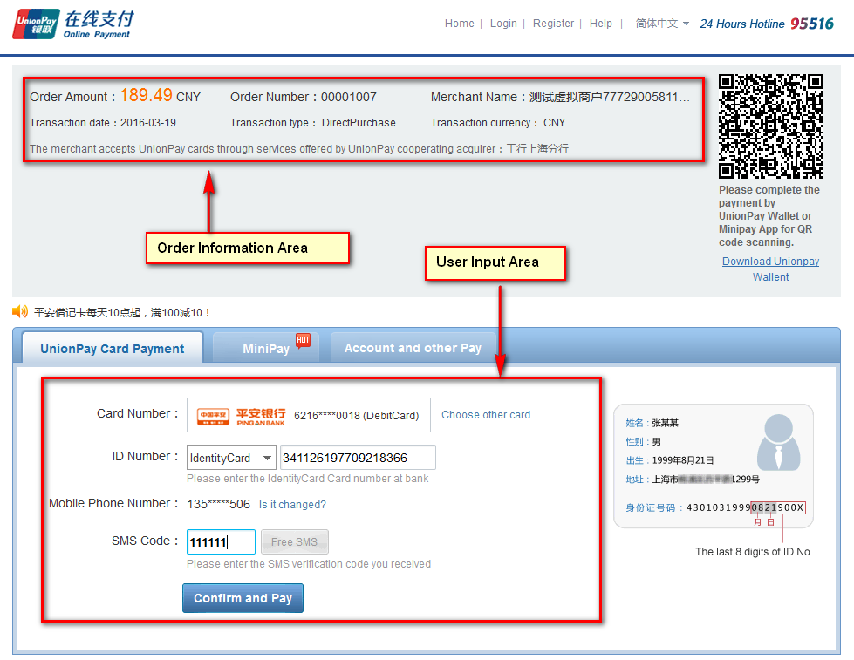
China pay: User payment process

Slide 22
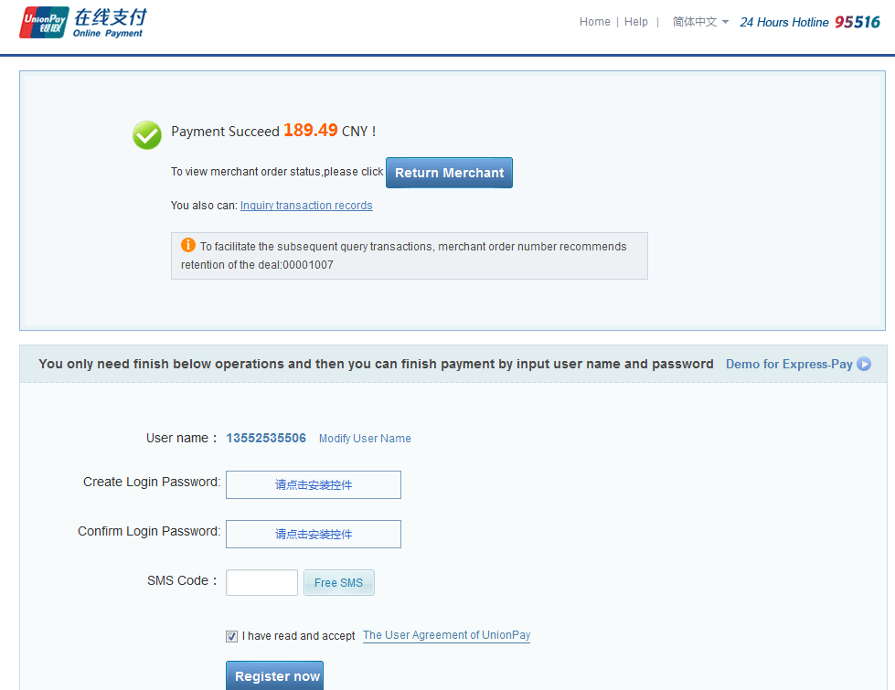
Payment result: Succeed

Slide 23
Step 4: Handle China pay response
Receive the response data
Validate the sign data
Update the payment transition status
Execute order process action

Slide 24
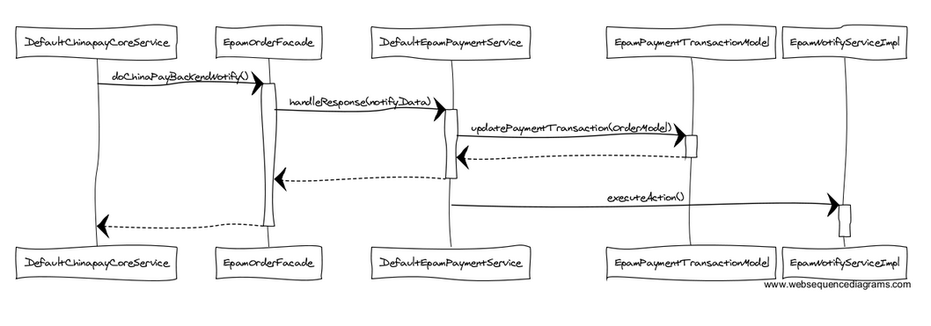
Sequence Chart

Slide 25
IMPLEMENT: 4.1 receive china pay response
DefaultChinapayCoreService
public String doChinaPayBackendNotify(
try{ ((EpamOrderFacade)getOrderFacade())
.handleResponse(notifyData,request.getParameterMap()); response.getWriter().print("success");
}catch (final Exception e){ LOG.error(e.getMessage(),e); response.getWriter().print("error"); } return null; }

Slide 26
IMPLEMENT: 4.2 Encrypt Validation
DefaultChinapayCoreService
public boolean verify(final Map<String, String> resData, String encoding) { LogUtil.writeLog("Start to verify"); if (StringUtils.isEmpty(encoding)) { encoding = "UTF-8"; } String stringSign = resData.get(SDKConstants.param_signature); // 从返回报文中获取certId ，然后去证书静态Map中查询对应验签证书对象 String certId = resData.get(SDKConstants.param_certId); //对返回报文串验签使用的验签公钥序列号 LogUtil.writeLog("public certId：["+certId+"]"); // 将Map信息转换成key1=value1&key2=value2的形式 String stringData = SDKUtil.coverMap2String(resData); LOG.info("Sign data：[" + stringData + "]"); try { // 验证签名需要用银联发给商户的公钥证书. return SecureUtil.validateSignBySoft(CertUtil .getValidateKey(certId), SecureUtil.base64Decode(stringSign .getBytes(encoding)), SecureUtil.sha1X16(stringData, encoding)); } catch (UnsupportedEncodingException e) { LogUtil.writeErrorLog(e.getMessage(), e); } catch (Exception e) { LogUtil.writeErrorLog(e.getMessage(), e); } return false; }

Slide 27
IMPLEMENT: 4.3 UPDATE THE TRANSITION STATUS
DefaultEpamPaymentService
private EpamTradeStatus updatePaymentTransaction(OrderModel order, PaymentNotifyInfoData notifyData, String type) { …… EpampayTransaction.setLatestTradeStatus(notifyData.getRespCode()); EpampayTransaction.setTradeEpamNo(notifyData.getOrderId()); getModelService().save(EpampayTransaction); getPaymentTransactionEntryPopulator().populate(notifyData, transaction); …… }

Slide 28
IMPLEMENT: 4.4 Execute order process action
EpamNotifyServiceImpl
public void executeAction(final OrderModel order) { final String result = checkPaymentTransaction(order); if ("OK".equals(result)) { setOrderStatusAction(order, OrderStatus.PAYMENT_CAPTURED); order.setPaymentStatus(PaymentStatus.PAID); } else { setOrderStatusAction(order, OrderStatus.CANCELLED); final OrderProcessModel orderProcessModel = (OrderProcessModel)businessProcessService.createProcess( "sendOrderCancelledEmailProcess-" + order.getCode() + "-" + System.currentTimeMillis(), "sendOrderCancelledEmailProcess"); orderProcessModel.setOrder(order); modelService.save(orderProcessModel); businessProcessService.startProcess(orderProcessModel); } orderService.saveOrder(order); }

Slide 29
TipS:
How to store the certification files
About CSRF allowed URL

Slide 30
TIPS 1 env Variables
For encryption certification files, It is not safe to upload the files with source code together
The certification files should be easy to use without code changes
It should work with different OS level
Define the system environment variables for the path
CERT_CHINAPAY_ENV_ENCRYPTCERT_PATH
CERT_CHINAPAY_ENV_SIGNCERT_PATH
CERT_CHINAPAY_ENV_VALIDATECERT_DIR

Slide 31
TIPS 2 CSRF Allow URL PATTERN
The hybris provide CSRF protection
For Chinapay gateway, we need to add our controller URL in the url pattern
Modify URL in project.properties in the Storefront extension
csrf.allowed.url.patterns=/[^/]+(/[^?]*)+(sop-response)$,/[^/]+(/[^?]*)+(merchant_callback)$,/[^/]+(/[^?]*)+(hop-response)$,/[^/]+(/[^?]*)+( language)$,/[^/]+(/[^?]*)+(currency)$,/+[(alipay)|(chinapay)]+/(.)*$

Slide 32
Q&A

Slide 33


